Slide 1


Slide 2
Topics
Hello Word Program
Variable
Constant and Final
Numbers (Int, double , etc)
Boolean
Strings
Assert
List
Map

Slide 3
Hello World Program
void main(List<String> arguments) {
print('Hello world');
// print is a function
// Hello world is object
}

Slide 4
Variable
Something that change over the time.
void main(List<String> arguments) {
var something = "Hello World";
print(something);
something = "New World";
print(something);
}

Slide 5
Constants & Final
Something that does not change over the time.
void main(List<String> arguments) {
const nope=1;
// nope=2;
final noper=1;
// noper =2;
}

Slide 6
Difference B/W Final & Constant
Final: a final variable or field must have an initializer. Once assigned a value, a final variable's value cannot be changed. final modifies variables.
Constant: const modifies values.

Slide 7
This code will work for constant
getConst(){
return const [1, 2];
}
main(){
var a=getConst();
var b=getConst();
print(a==b);// true
}

Slide 8
Numbers
In dart everything is an object.
Ineteger and Double are subpart of numbers.
void main(List<String> arguments) {
num age=12;
age +=20;
print(age);
num marks=12.5;
print("Age is $age and Marks are $marks");
//Using $ sign we can call external variable.
print("Age is :"+age.toString());
}

Slide 9
Boolean
By default value of any Boolean is false
void main(List<String> arguments) {
bool isWorking;
print(isWorking);
isWorking=true;
print(isWorking);
}
Output:
false
true

Slide 10
Strings
It is a sequence of Character.
void main(List<String> arguments) {
String title="Hello World!!!";
title+=" from India";
print(title);
}
Output
Hello World!!! from India

Slide 11
Assert
It is a function what ever we pass through this function that must return true.
void main(List<String> arguments) {
String names="Prateek,Angad,Satkriti,Ubaid";
assert(names.contains("Prateek"));
// if we write meher instead of Prateek it will through an error.
}

Slide 12
List<E>
List of Similar type of objects.
void main(List<String> arguments) {
String names="Prateek,Angad,Satkriti,Ubaid";
List<int> intList=[1,2,3,4,5];
List<String> stringList=names.split(",");
print(intList);
stringList.forEach((value){
print(value);
});
}

Slide 13
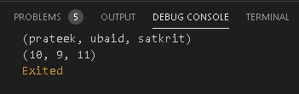
Map<E,E>
Its basically a set of key value pairs.
void main(List<String> arguments) {
Map<String,num> marks={
"prateek":10,
"ubaid":9,
"satkrit":11
};
print(marks.keys);
print(marks.values);
}

Slide 14
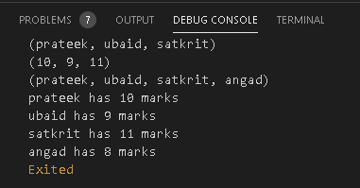
void main(List<String> arguments) {
Map<String,num> marks={
"prateek":10,
"ubaid":9,
"satkrit":11
};
print(marks.keys);
print(marks.values);
marks["angad"]=8;
print(marks.keys);
marks.forEach((k,v){
print("$k has $v marks");
});
}

Slide 15
Thank You

